Slide 1
Zhongjian Xu
T1A2-Portfolio

Slide 2
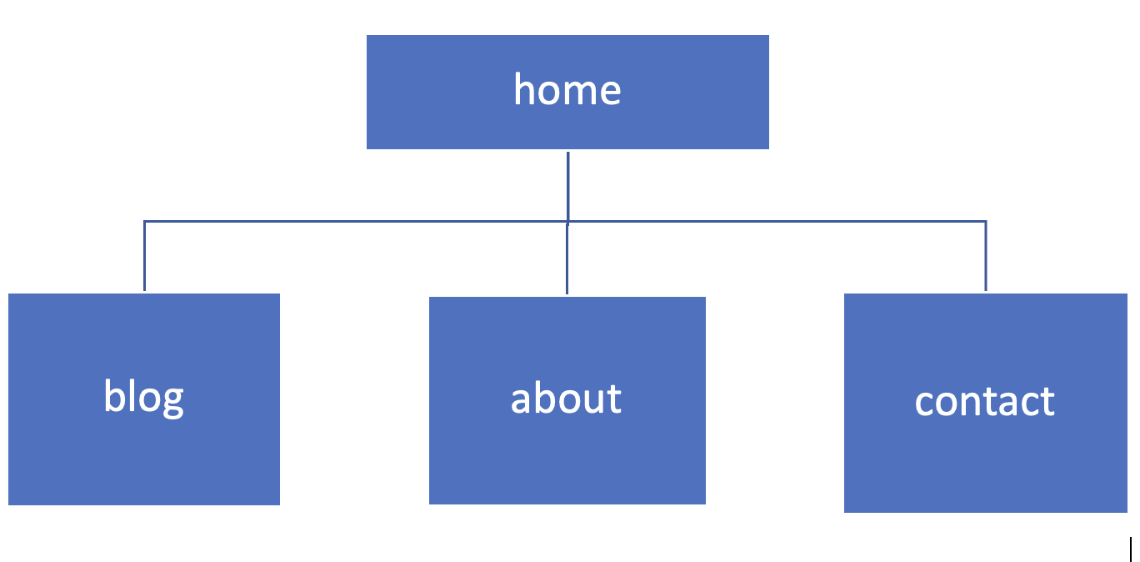

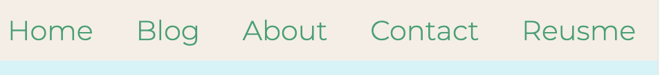
sitemap
On the website has 4 Html pages and a resume, linked by a navigation bar across the website.
navigation bar

Slide 3
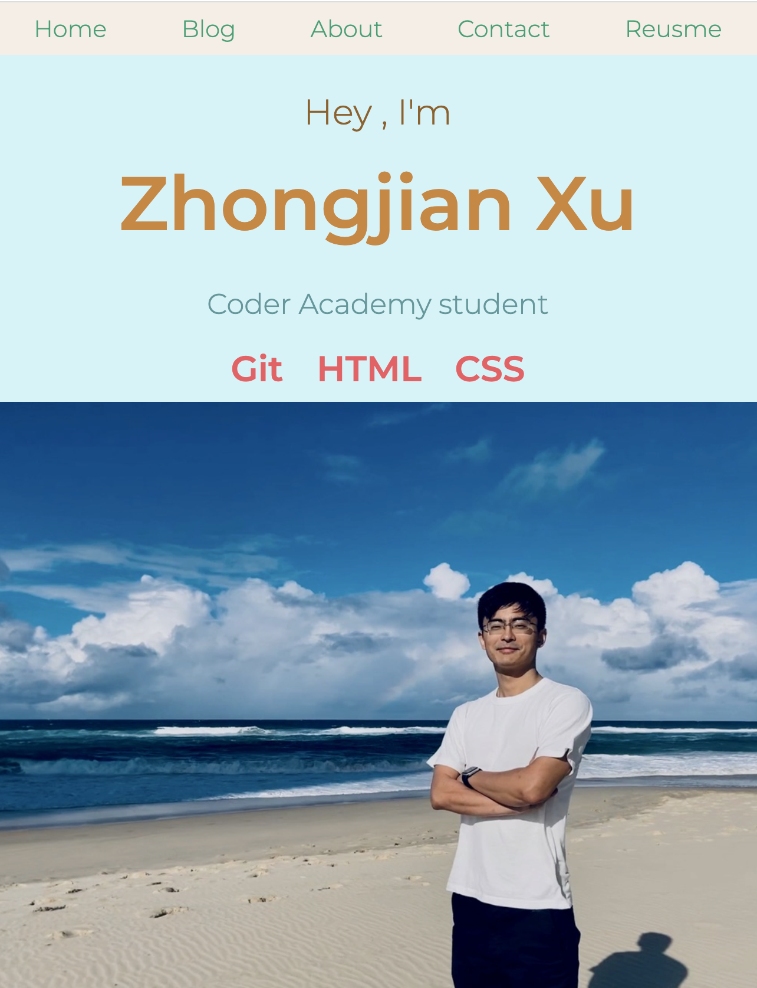
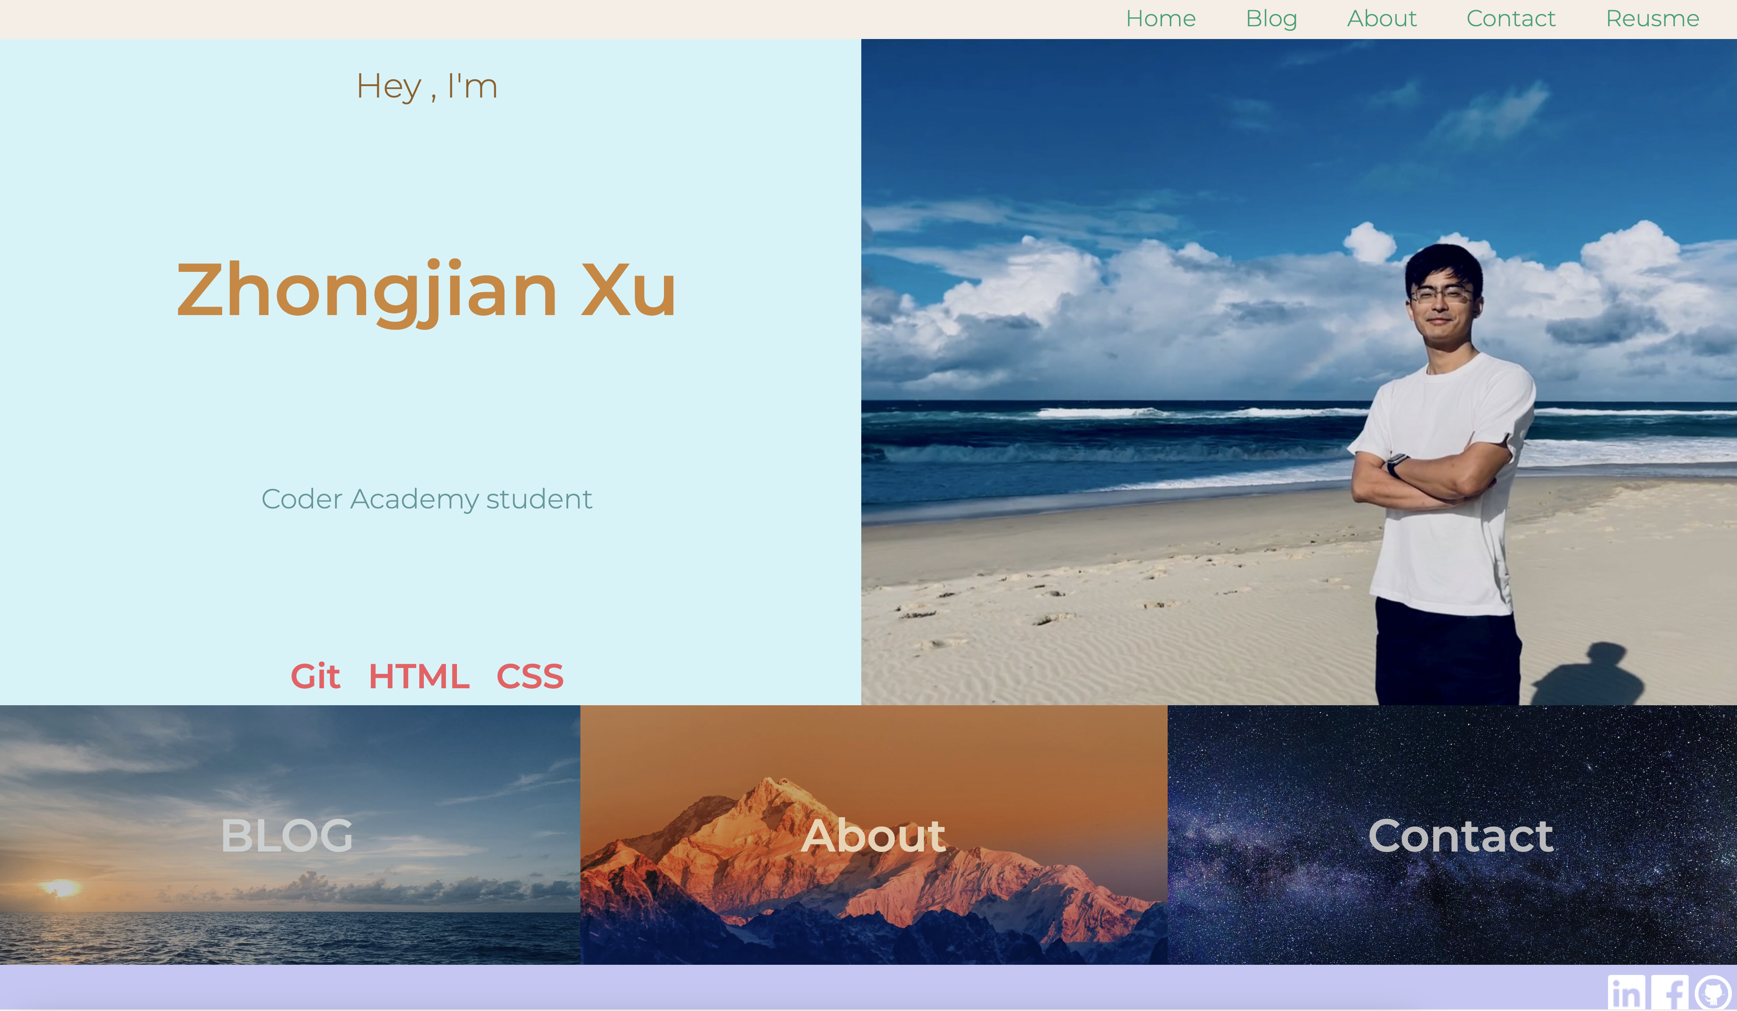
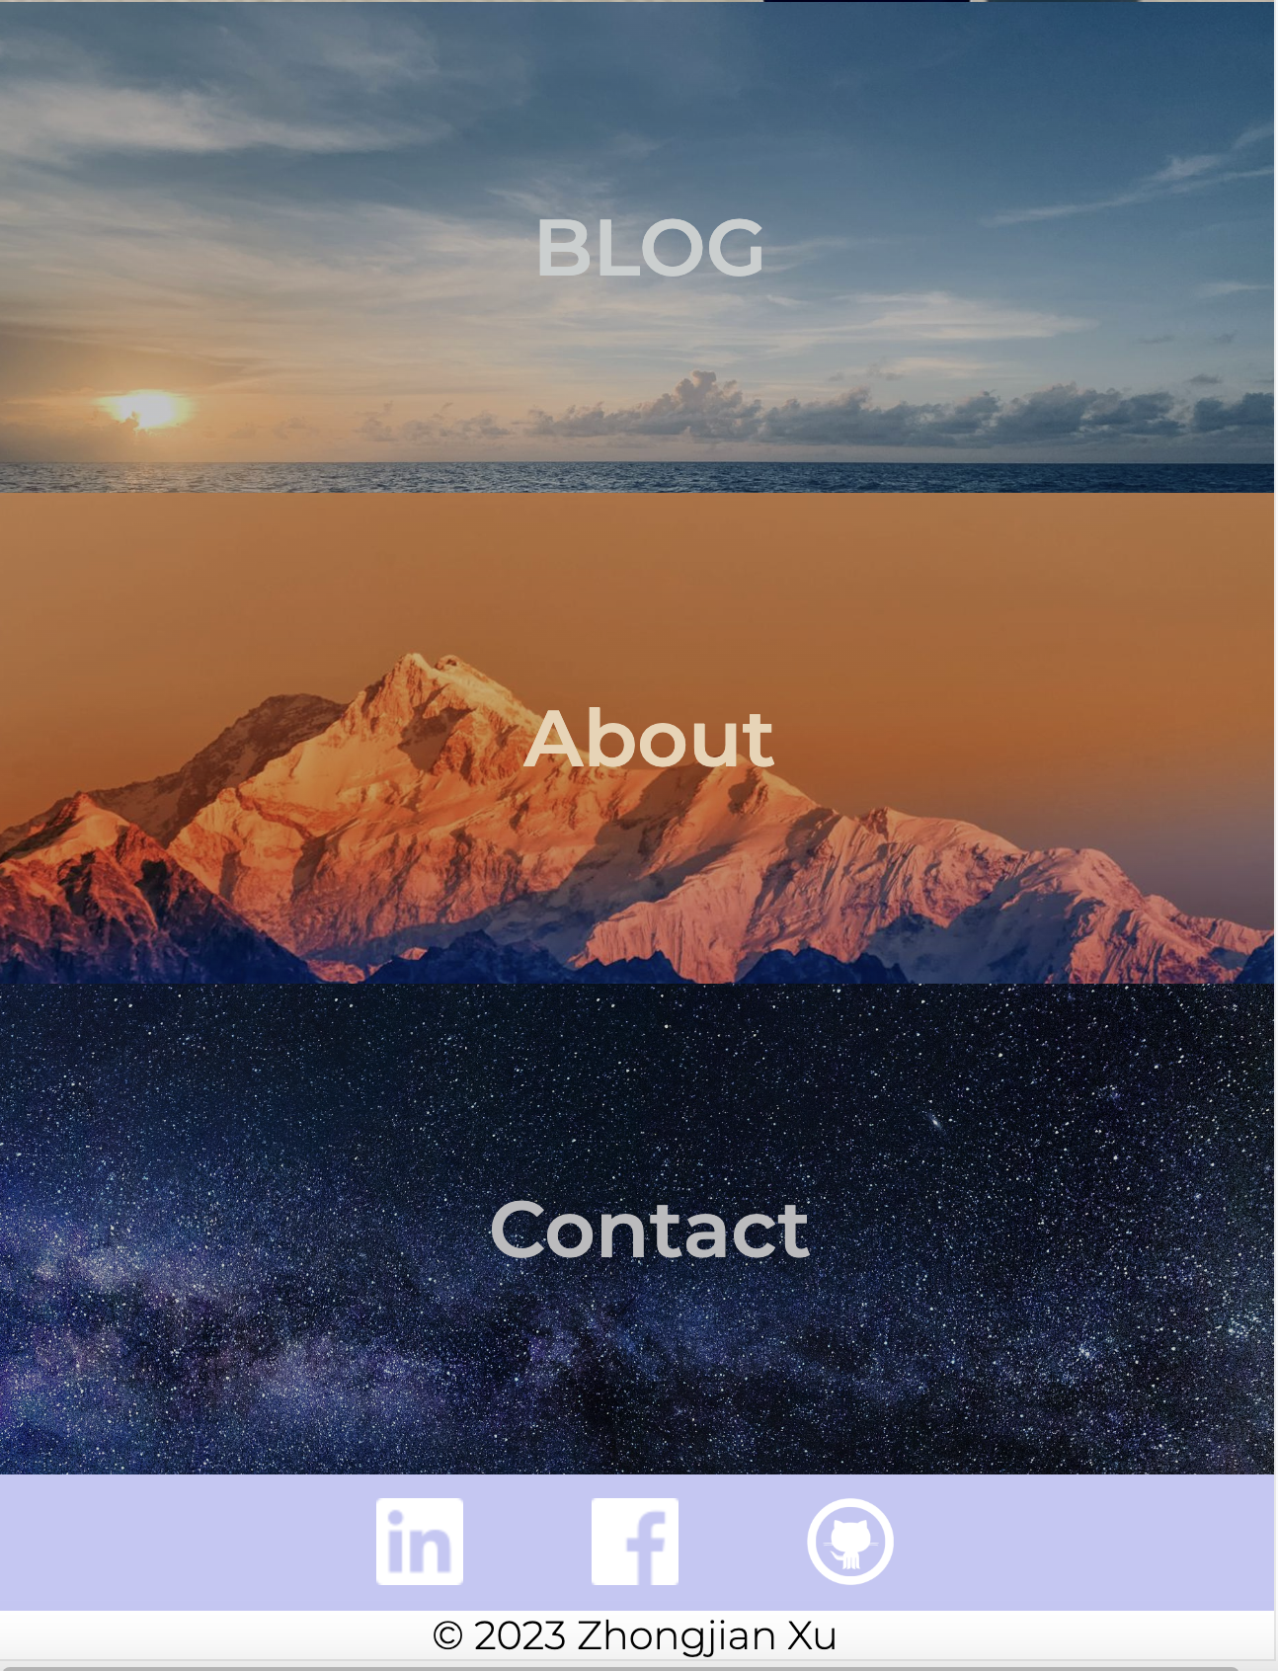
Mobile’s view
On the home page, the “hero” section includes my name and picture, to give the audiences the first impression.
On the bottom, There are three anchor links to other pages with sightseeing background.
The layout of the page is using “flexbox”, it switches between “row” or “column” depending on the view size.
Mobile view
Bigger screen’s view

Slide 4
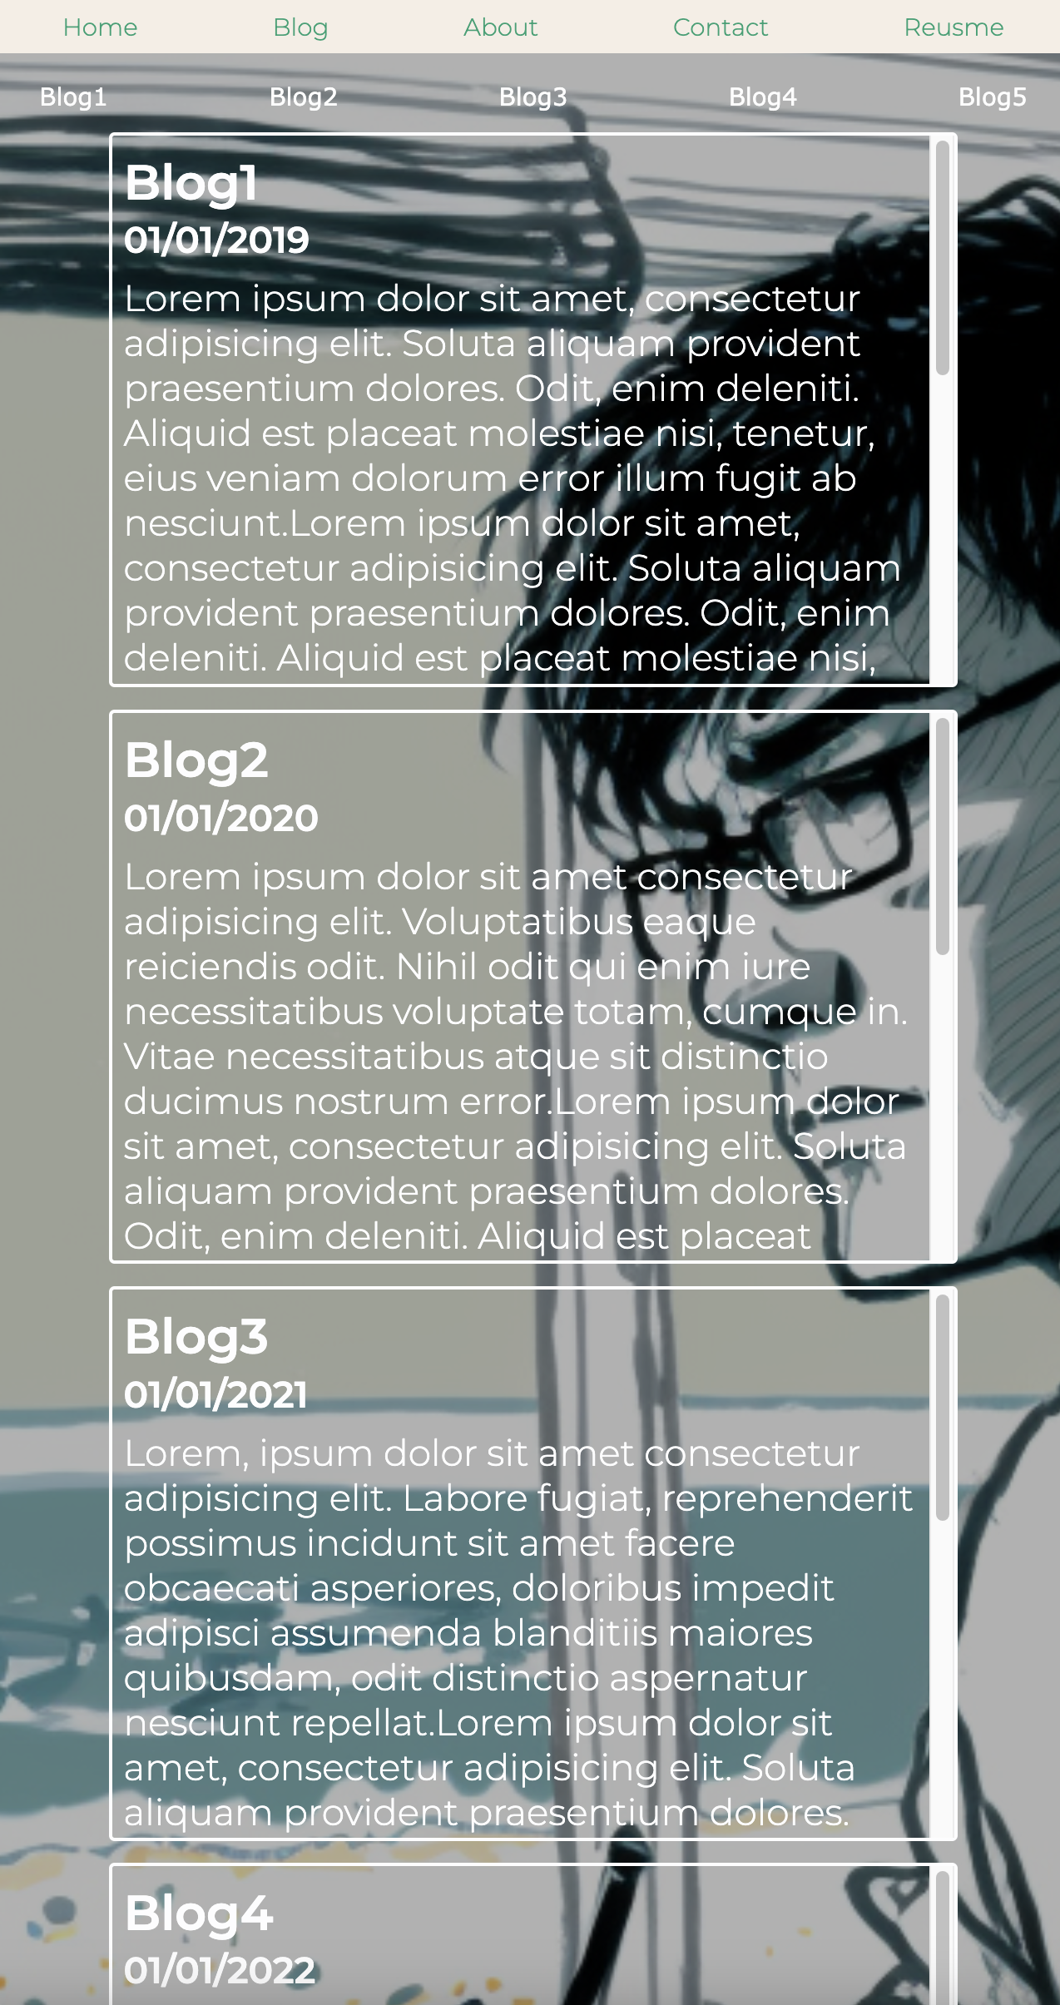
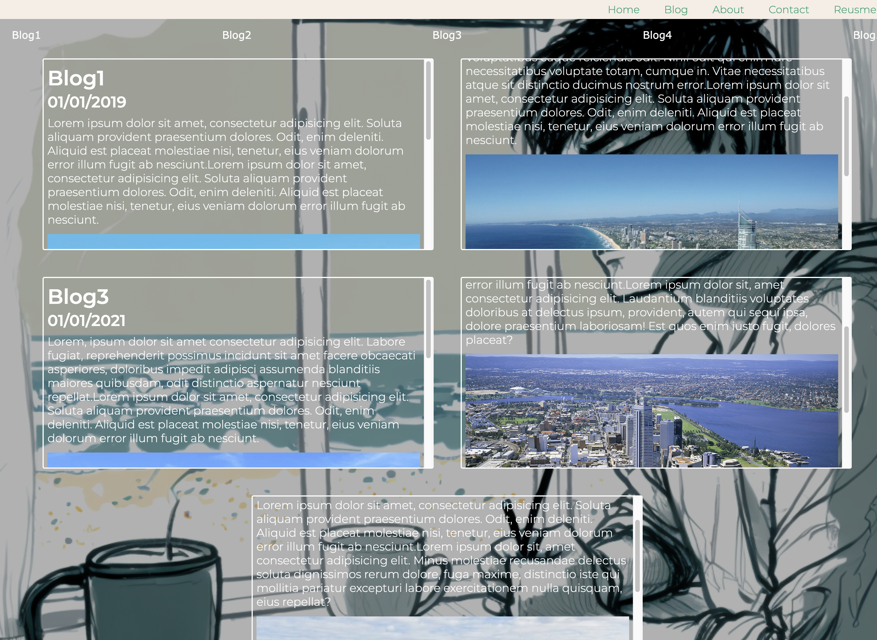

Similar to homepage, The blog page also use “flex” layout, consisting of 5 placeholder blogs.
There’s a blog navigation bar and a “back to top” button at the bottom of the page.
There’s a background picture created by Midjourney throughout the whole body, to enhance the “blog” theme.

Slide 5
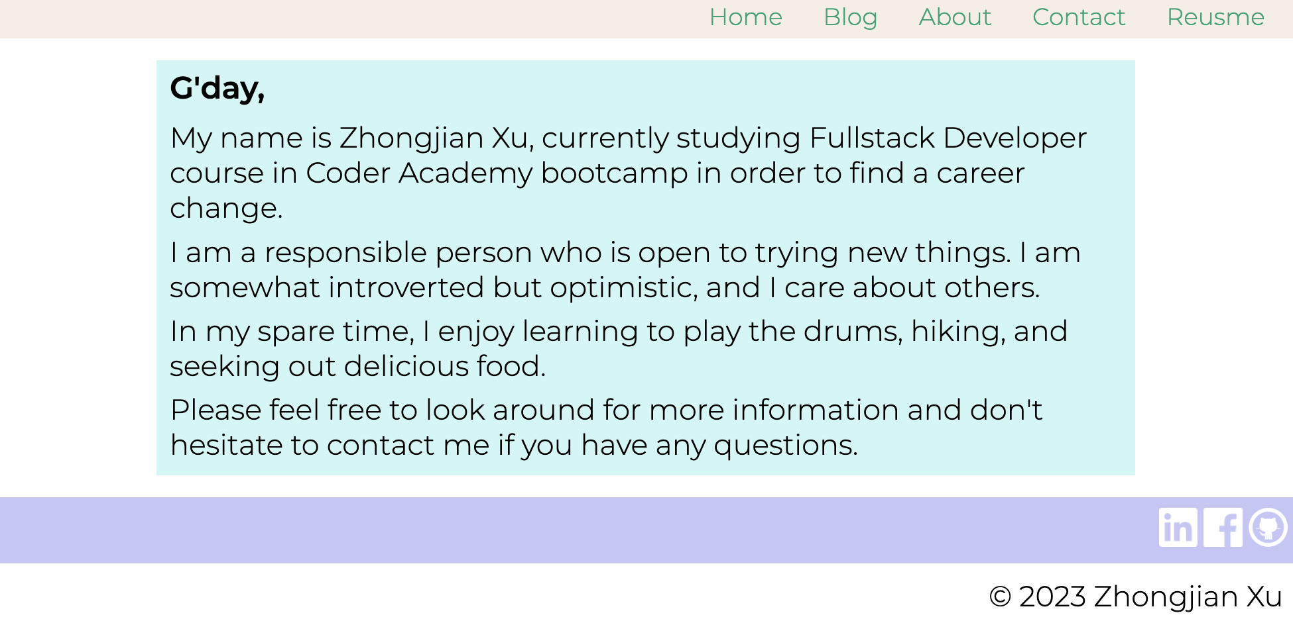
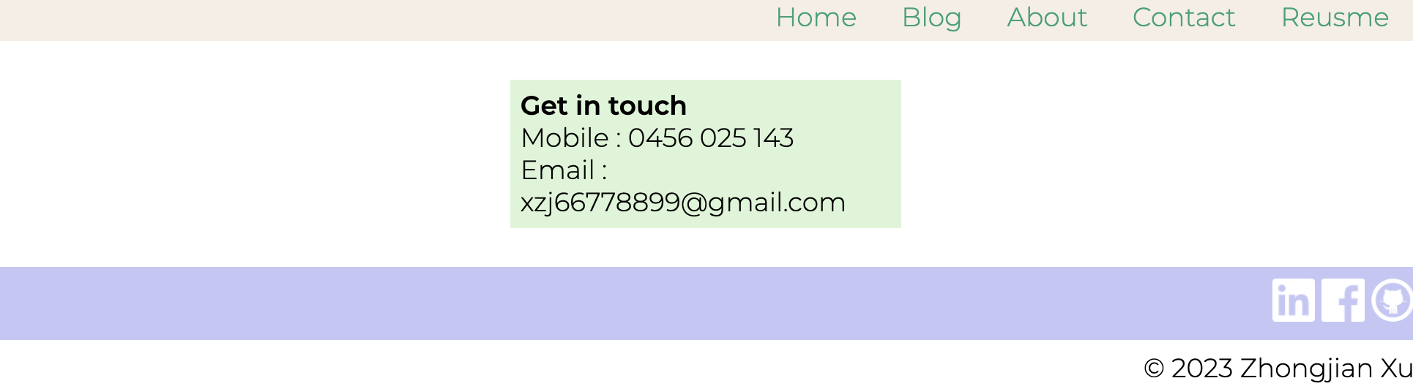
“About” & “Contact” are formed by two articles describe my self-introduction and contact details.
At the bottom of each page, there’re three “social links” to Linkedin, Facebook and Github.

Slide 6
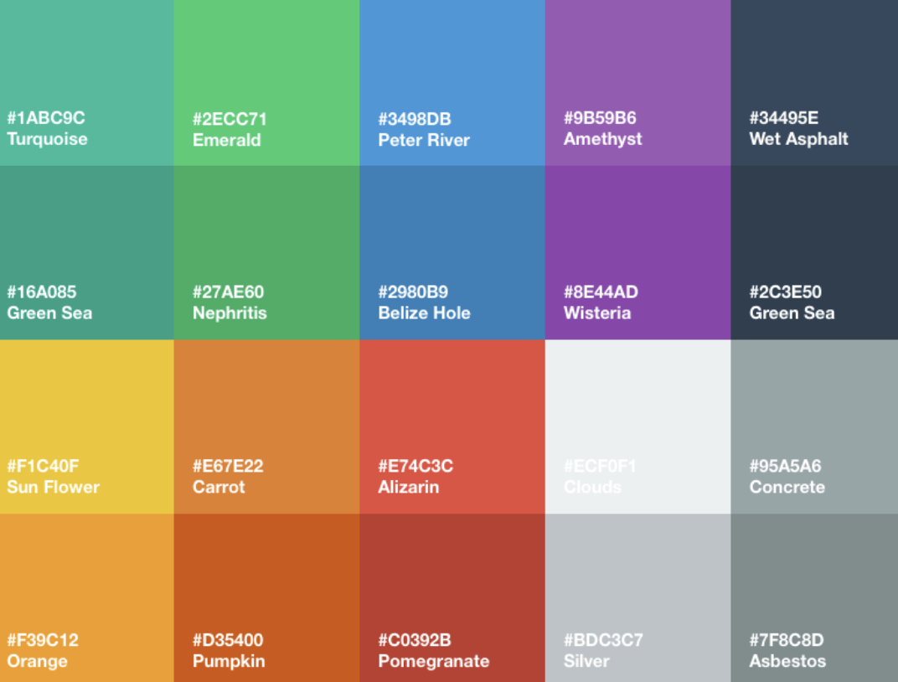
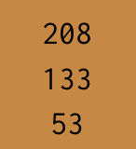
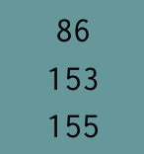
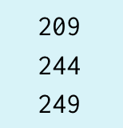
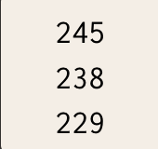
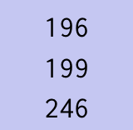
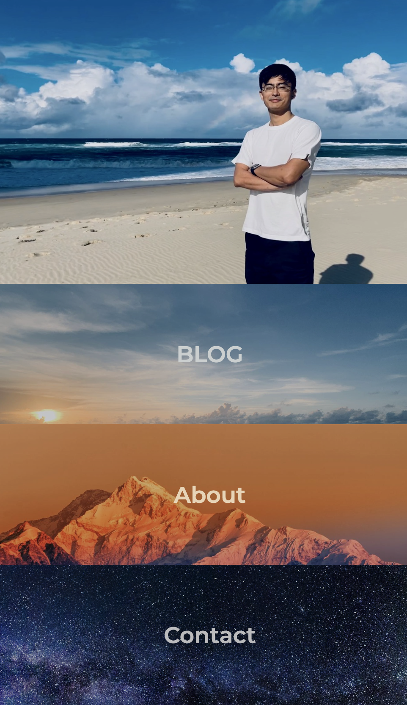
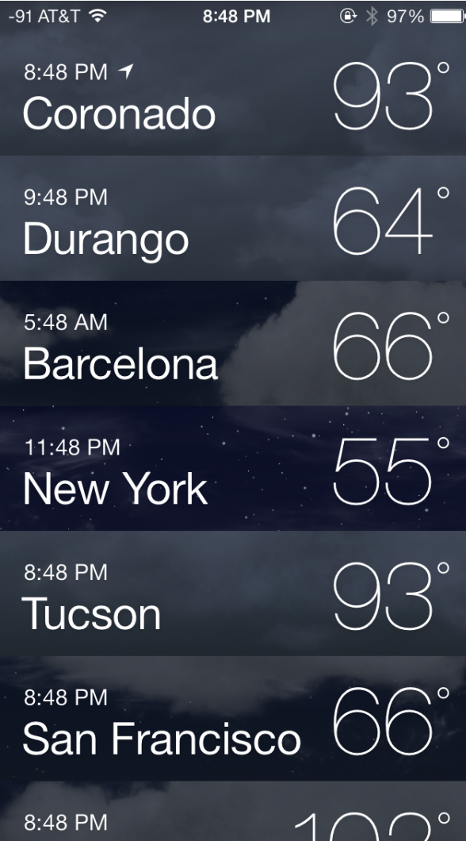
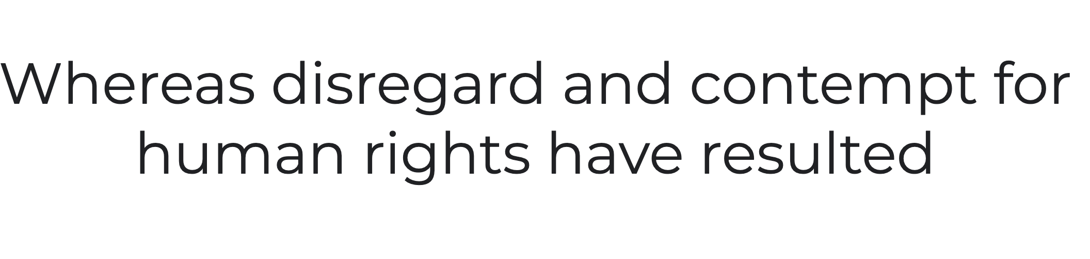
Overall aesthetic design
The idea of the overlooking of the website came from “flat design”. The first time I knew it is when IOS7 released for Iphone in 2013. It totally changed the aesthetic design of Iphone interface. I was impressed and loved it since then.
So for the first step, I chose the elements’ color as close as to the IOS7 color.
Colors chosen
Colors for IOS7
Secondly,
I chose “Montserrat” as the font, which is close to the flat design style.
Thirdly, by using flex, some elements stack seamlessly, such as part of my home page, which inspired by the “weather” in IOS7.
font chosen: Montserrat
Portfolio homepage
IOS7 “weather”

Slide 7
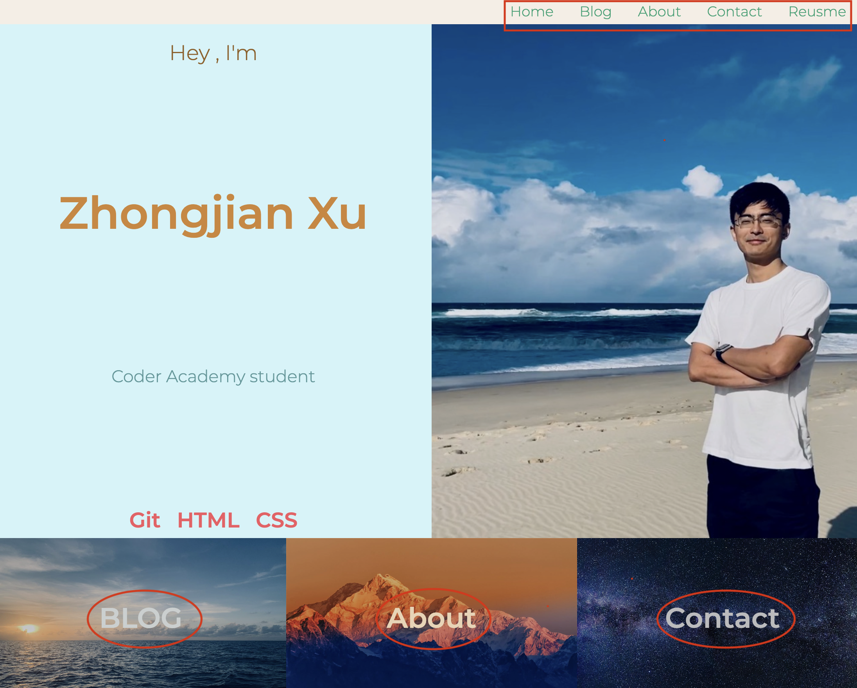
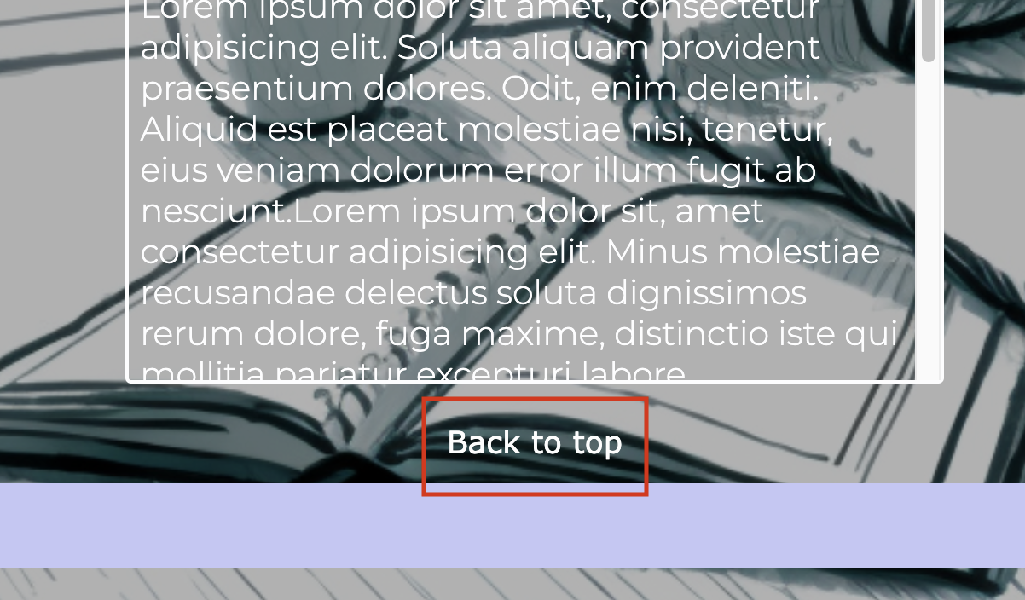
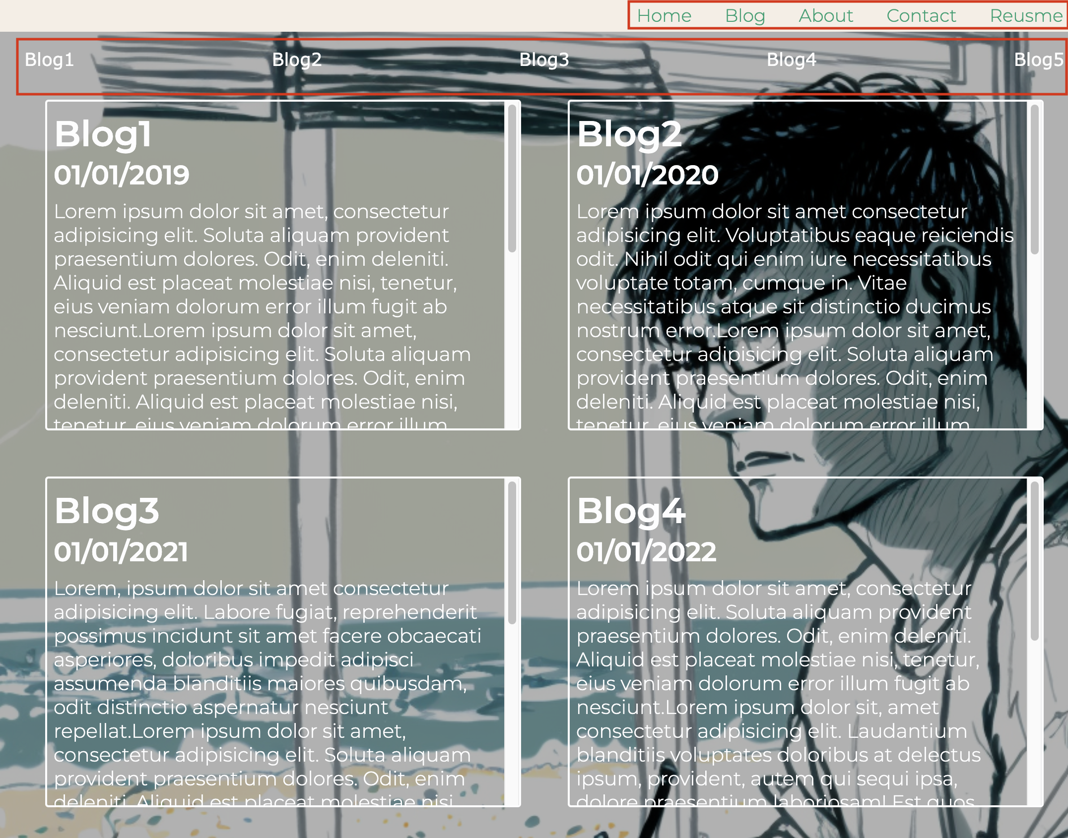
Visual effect
There’re some hover effect on the links throughout the website, which not only attract audiences’ attention but also can increase their engagement by clicking the links.
The contents inside the redline in the pictures indicate there’re hover effects.

Slide 8
Components:
my name and picture: Give audiences a good first impression.
anchor links to other pages with background:
Let audiences go to other pages more easily rather than navigation bar.
5 blogs and three “social platform links”
It’s a way to show yourself to audiences.
“about”: Self-introduction is a necessary to audiences, give them a general idea who I am.
“contact”: They can direct contact me through the given email and phone number.

Slide 9
Difficulties and challenges
Favourite parts

